Slide 1

SpotPhish
Zero-hour phishing protection
Nullcon 2018

Slide 2
What is SpotPhish?
Browser plugin for zero hour phishing protection
Perceptual technique, amplify visual difference between real and fake pages
Usable by all - not just the security conscious
Does not require modification of existing behaviour and workflows
Open source!

Slide 3

Mutual Authentication
Website authenticates to client
Factor 1: Look and feel (“Face ID”)
Factor 2: SSL Certificate
Client authenticates to website
Factor 1: Username, password
Factor 2: PIN, U2F..
Problem
Human looks at the face, not the certificate
Browser looks at the certificate, not the face
No single entity looks at both factors.
Neither human nor browser matches the face to the name
paypal.com
SSL certificate
“Face ID”
name, pwd
Firefox
✔
✔
Human
Client

Slide 4
Mutual Authentication - phishing
Website authentication flow
Factor 1: Face looks like Paypal, human is happy
Factor 2: SSL cert CN paypal-phish.com matches URL domain, browser is happy
Human hands over keys to the kingdom
Phishing happens because the server authentication flow uses insecure “Face ID”!
paypal-phish.com
SSL certificate
“Face ID”
name, pwd
Firefox
✔
✔
Human
Browser

Slide 5
The Gap
Both factors - Face ID of a page and its (certified) domain must correspond and be verified together
Browser can’t “see” the Face ID
Humans ought to be doing it - they can see the page, the address bar, and check the certificate
So why don’t they?

Slide 6

How we get phished
System 1 - “GPU”
Subconscious, effortless, intuitive, emotional
Recognizing faces, walking through familiar spaces
Navigating user interfaces
Escalates to System 2 on confusion or surprise
System 2 - “CPU”
Effortful, slow, consciously allocates attention
Park into a tight space
Writing emails, buying stock

Slide 7
How we get phished
UI Prime Directive: Effortlessly navigable by System 1; involve System 2 only when necessary
System 1 carries out routine tasks like logging in “without thinking”
System 1 autocorrects; if you did not see the the typo in the domain name, it’s not your fault
Login dialogs are effectively random; you have no predictive model
Phishing messages deliberately hijack System 2’s attention by claiming to be from your boss, or bank, raise urgency
Notes:
When people say a UI is intuitive, they mean “usable almost exclusively by System 1”
Blind spot
non-ssl, unknown domain doesn’t interrupt system 1 flow
Who’s gonna look at the address bar when your job’s on the line?

Slide 8
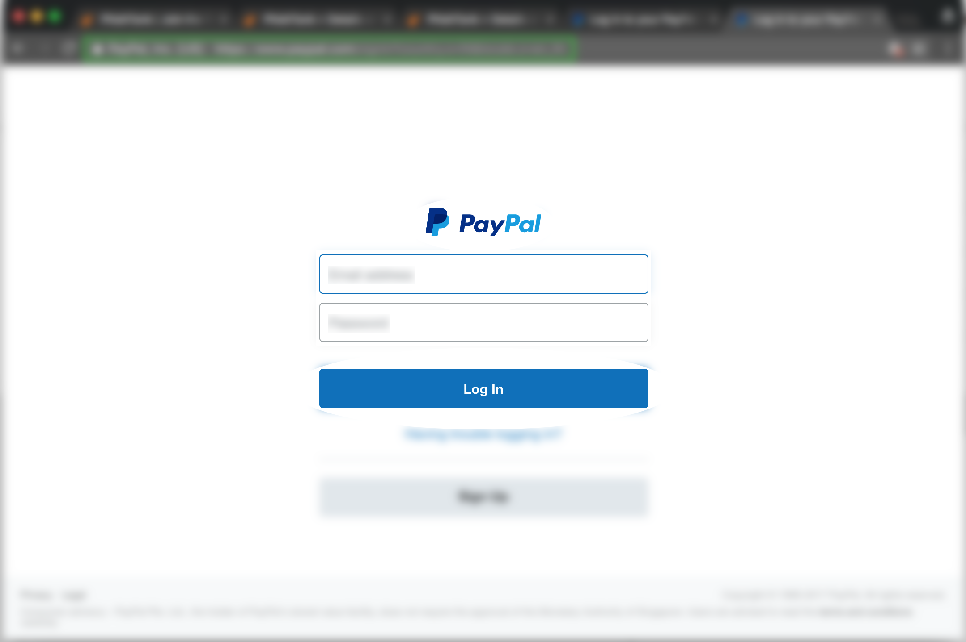
Face ID
What humans use to identify Paypal - its “look and feel”

Slide 9

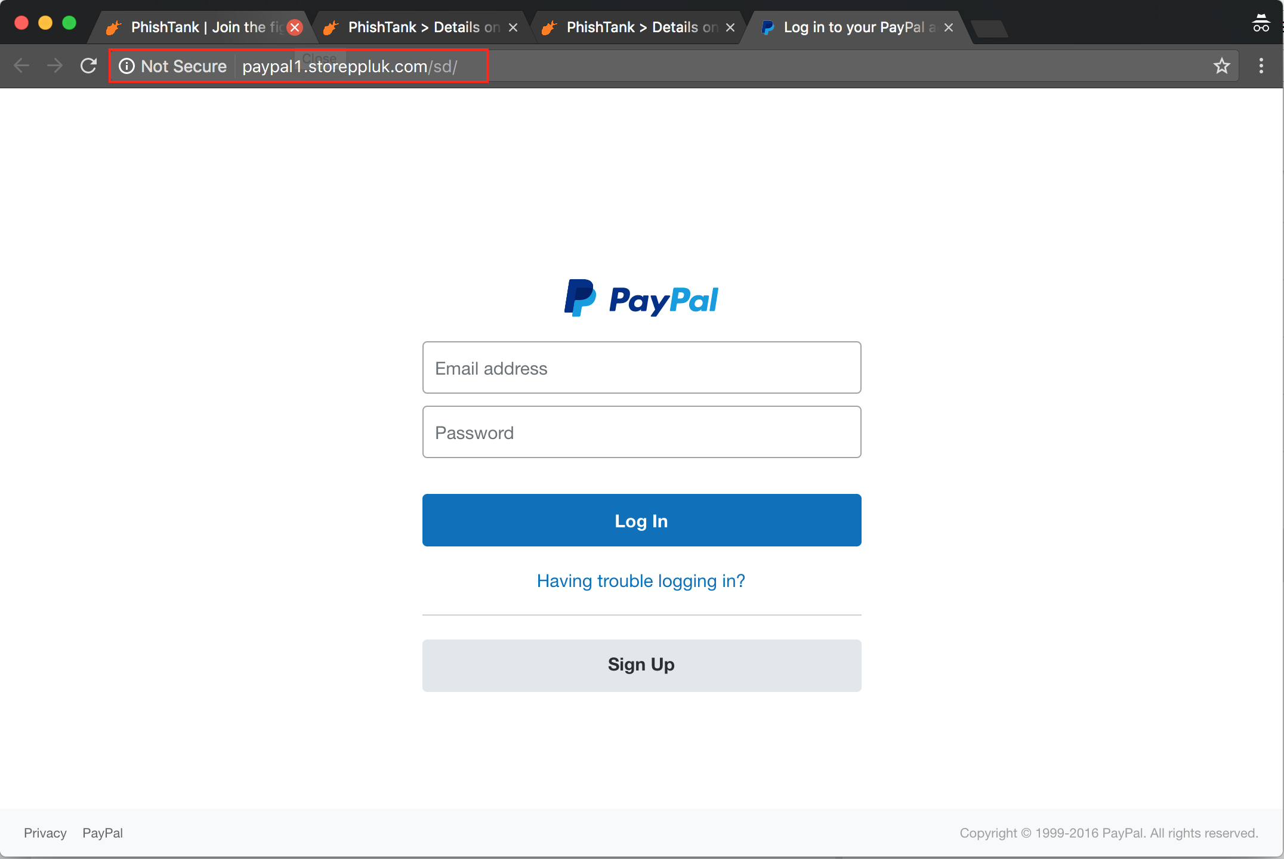
Diff(Real, Fake) ≈ 0
Diff(Real, Baseline) = 0
Diff(Fake, Baseline) ≈ 0
Real page
Mental baseline
Fake page
Notes:
Many tricks, redirecting attention, urgency, appeal to authority, etc. But you could drive up all those as high as you want, and still fail if you don’t point to a page which looks visually similar to what the user is expecting. Sight is our most important sense.

Slide 10
How do we plug the hole?
Authentication must consider both Face ID of a page and its domain name
A given user has perhaps a dozen important accounts vulnerable to phishing; make a whitelist of the URLs and their corresponding Face IDs
Human System 1: along with the rendered page, present the name in a visually consumable manner
Browser: Teach it to “see”; warn if a web page presents a whitelisted Face ID, but has a different domain name.

Slide 11
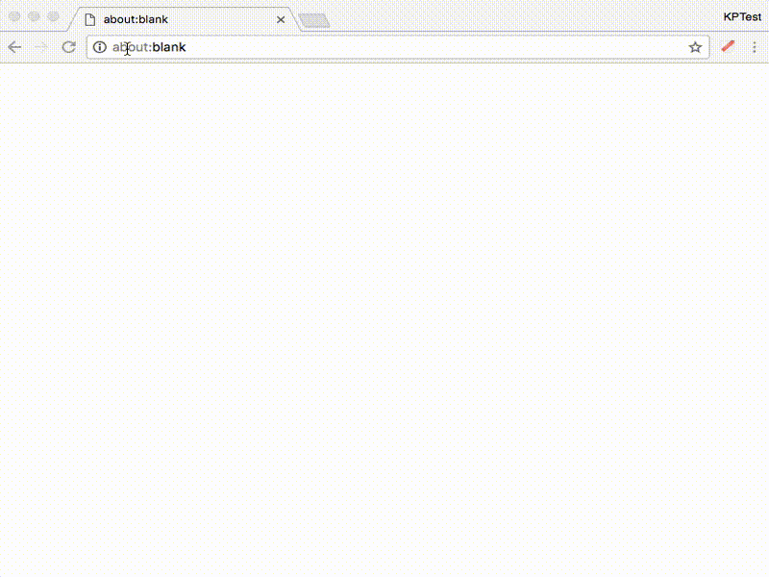
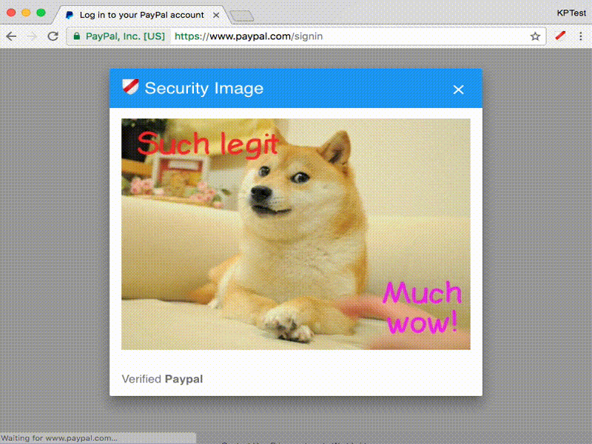
Augmented Face ID
Shared secret image between user and browser
Service unaware of the secret
Displayed for ~ 2 sec on whitelisted URLs
Changes Paypal’s perceived Face ID from “Paypal logo” to “Secret image, then Paypal logo”
Gradual conditioning => user notices absence of image

Slide 12
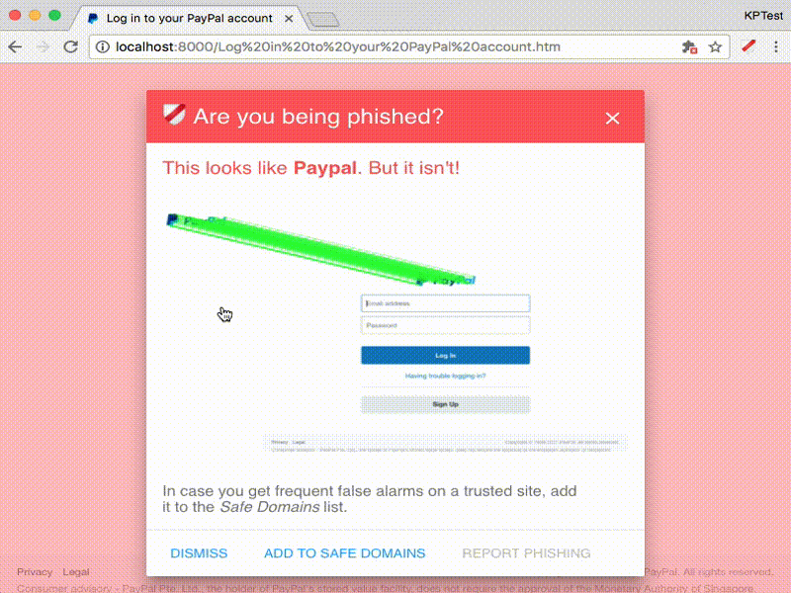
Teach the browser to spot phish
Untrusted page, user hits a key - take a screenshot!
Look for Face IDs of whitelisted pages
Show why we think this is a phish

Slide 13
SpotPhish
Maximise perceptual difference between real and fake
Mitigates false negatives

Slide 14
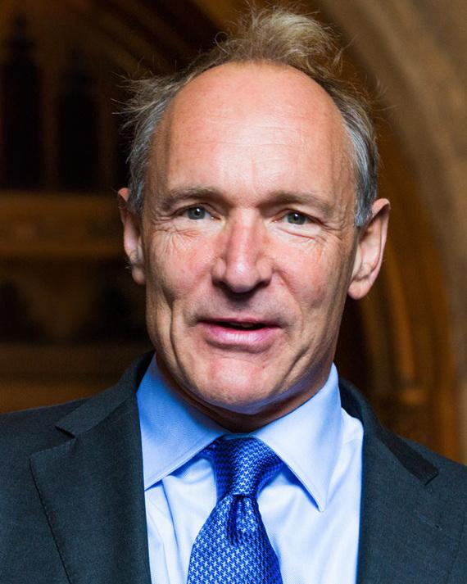
In the beginning...
“I imagined the web as an open platform that would allow everyone, everywhere to share information, access opportunities and collaborate across geographic and cultural boundaries.”
Tim Berners-Lee, March 2017
Notes:
Nigerian spam

Slide 15
3 Chinese Curses
Decentralized - May you live in interesting times!
Hard to shut you down - freedom of speech
Hard to shut abusers down
Cheap - May you get what you wished for!
Low cost barrier to access and publish content, send messages
Spam
Anonymous - May you be recognized by those in authority!
Privacy, freedom to voice unpopular opinions
Trolls, bots
Notes:
Centralized, cheap, nonymous - corporate network, WhatsApp
Decentralized, cheap, nonymous - credit rating

Slide 16
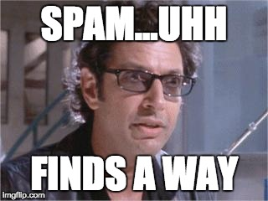
Life, the Internet and Everything
Decentralized + cheap + anonymous makes spray-and-pray a viable strategy
Spam is inevitable
Organisms in open systems - from bacteria to computers - evolve immune systems to survive
Co-evolution, arms race between spam and immune system

Slide 17
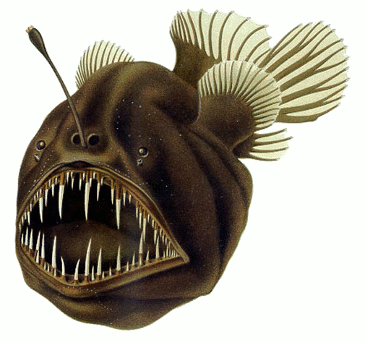
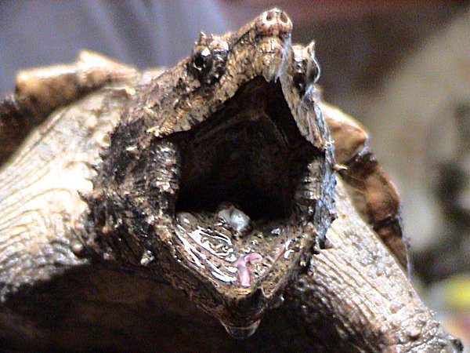
Aggressive mimicry - phishing attacks in nature
Angler fish
Alligator snapping turtle

Slide 18
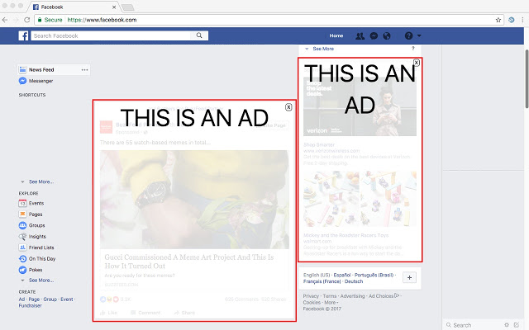
Advertising arms race
HTML/CSS based ad filter
Tweak layout
Facebook DOM structure same for ads and non-ads
Perceptual ad blocking - fuzzy image matching to identify AdChoices icon
“The Future of Ad Blocking”, CITP Princeton
Source: Mike Hearn’s post on “Modern anti-spam and E2E crypto”

Slide 19
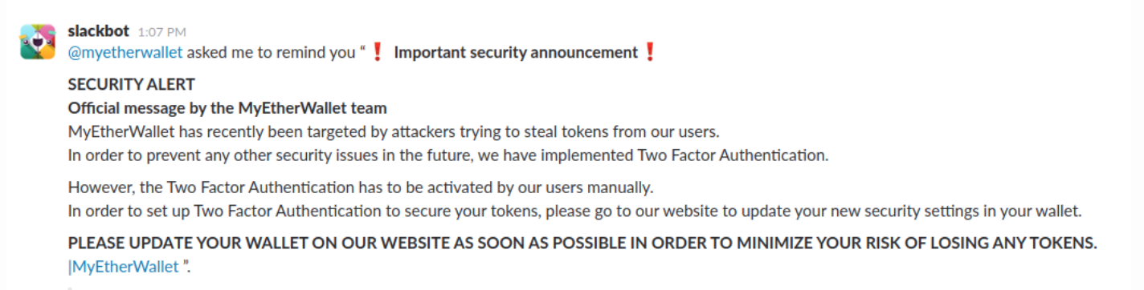
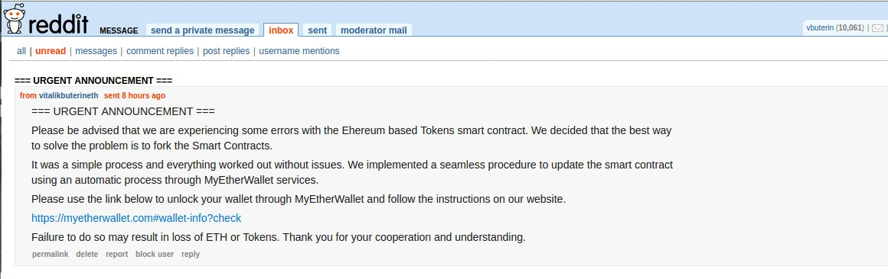
Phishing arms race - messaging
Attackers must (cheaply!) get a message with a link to the victim
Attackers send phishing emails
Big vendor anti-spam reduces spam to near-zero
Attackers use media more vulnerable to spam
Hacked email accounts
Forums: reddit, blogs
Facebook, Twitter, Slack

Slide 20
Phishing arms race - authentication methods
Passwords leak due to phishing and data breaches
Web services roll out 2-factor authentication
MITM phishers recover second factor as well
Web services add support for U2F
Password managers
This is great, but requires significant change in user behaviour and workflow; low adoption by lay users

Slide 21
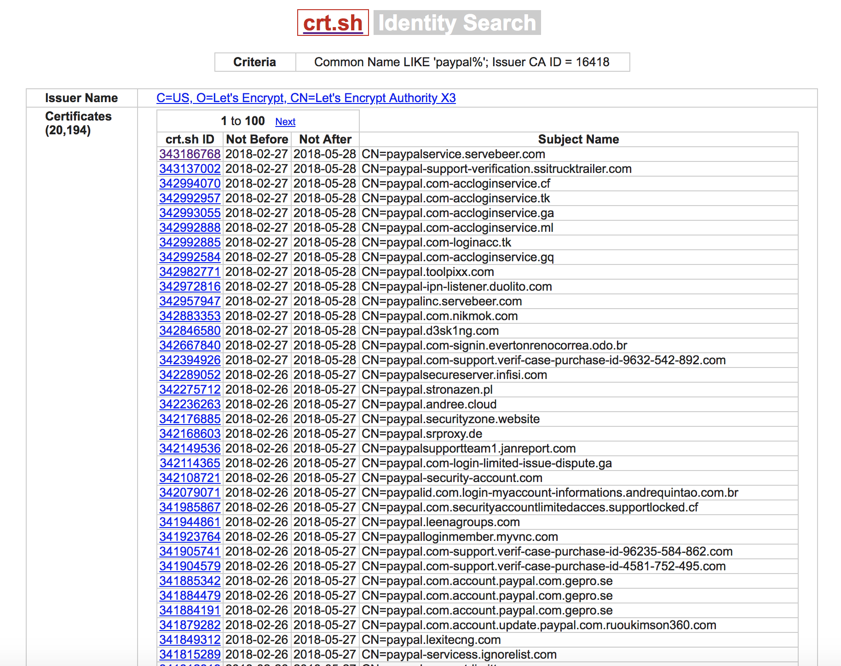
Phishing arms race - browser
Phishing sites use HTTP - SSL certs expensive
Green padlock displayed by browser => “secure” site
conflates encrypted transport with trustworthiness
Phishing sites use free certificates from Lets Encrypt
Endgame: Green padlock useless as a symbol of trust

Slide 22
Phishing arms race - browser
Crowdsourced URL blacklist; big red warning if page flagged for phishing
Create several domains and pages to propagate the same attack
Blacklist evasion
Anti-blacklist blacklist: Adblock-like service for security domains; display 404 when visited by security companies, VPS
Whitelist: block everyone except target location, ISP
Use geolocation, browser fingerprinting, IP address to prevent multiple visits from same user
Endgame: Blacklists not as effective as we think; pages can remain under the radar for days, even months

Slide 23
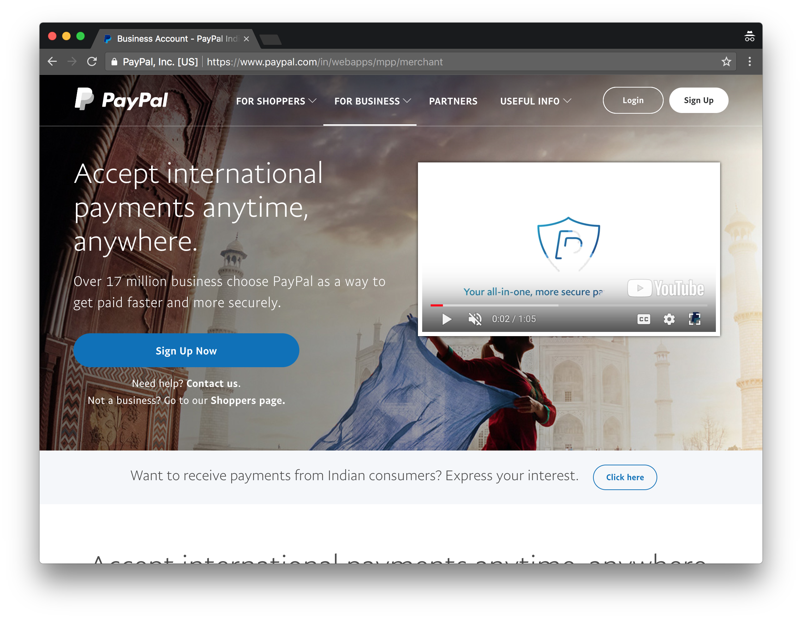
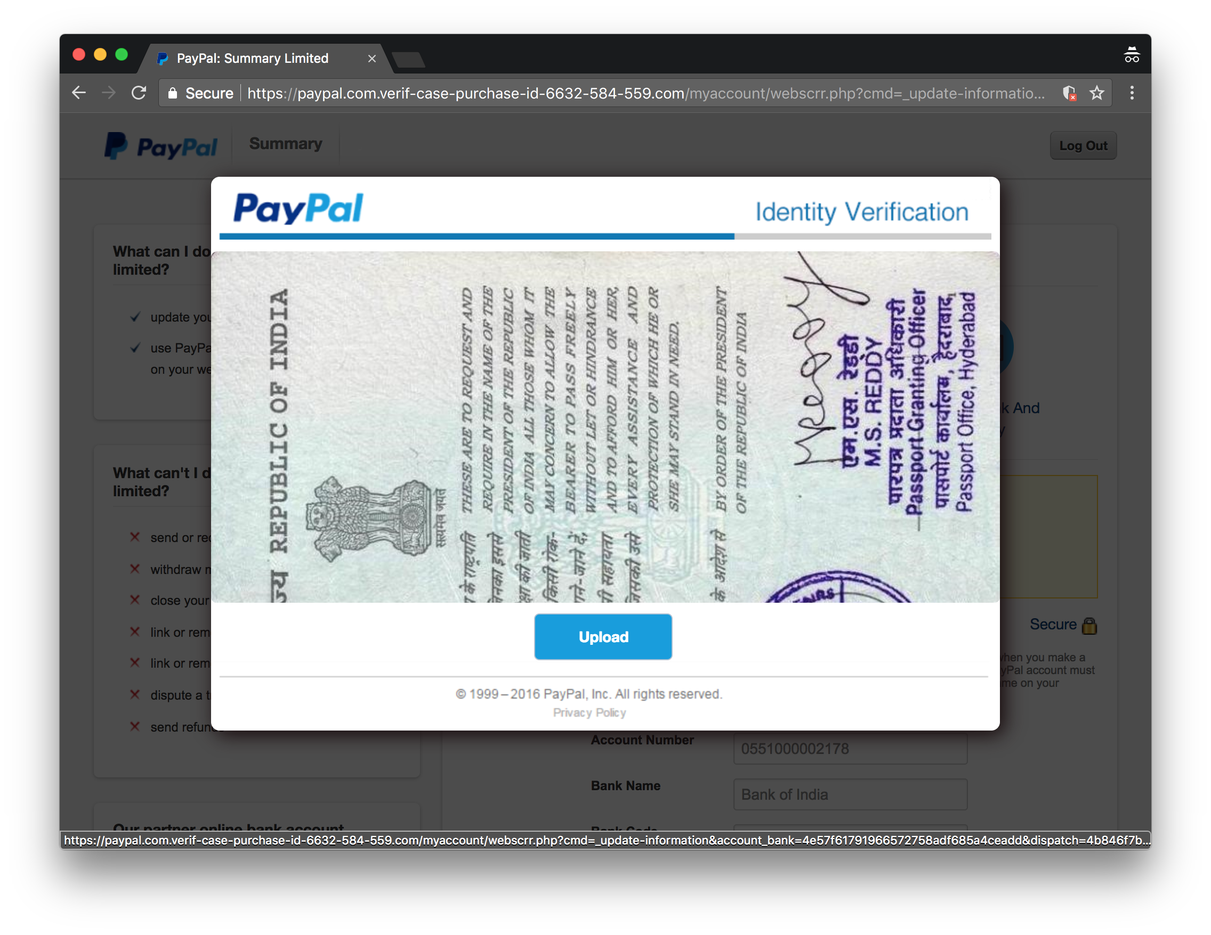
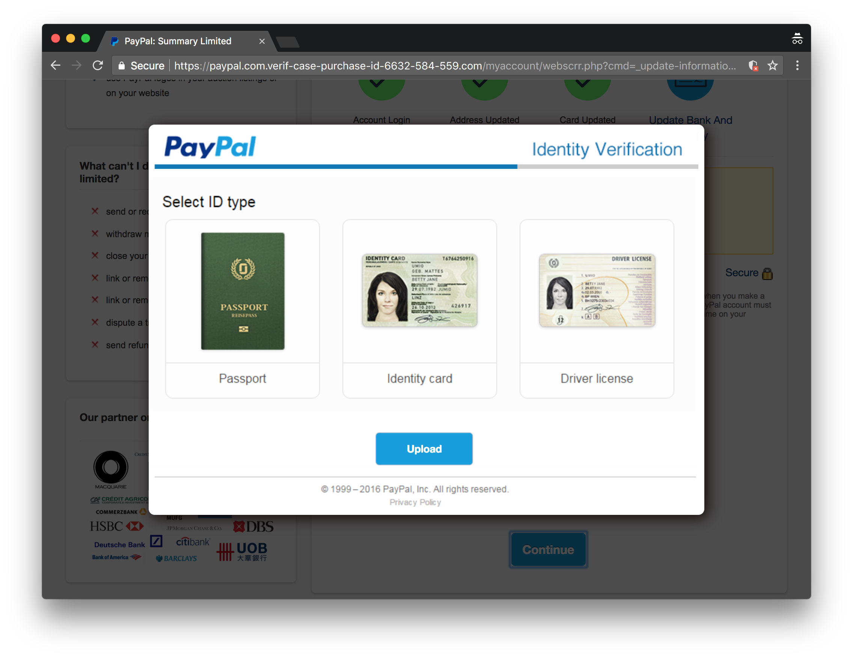
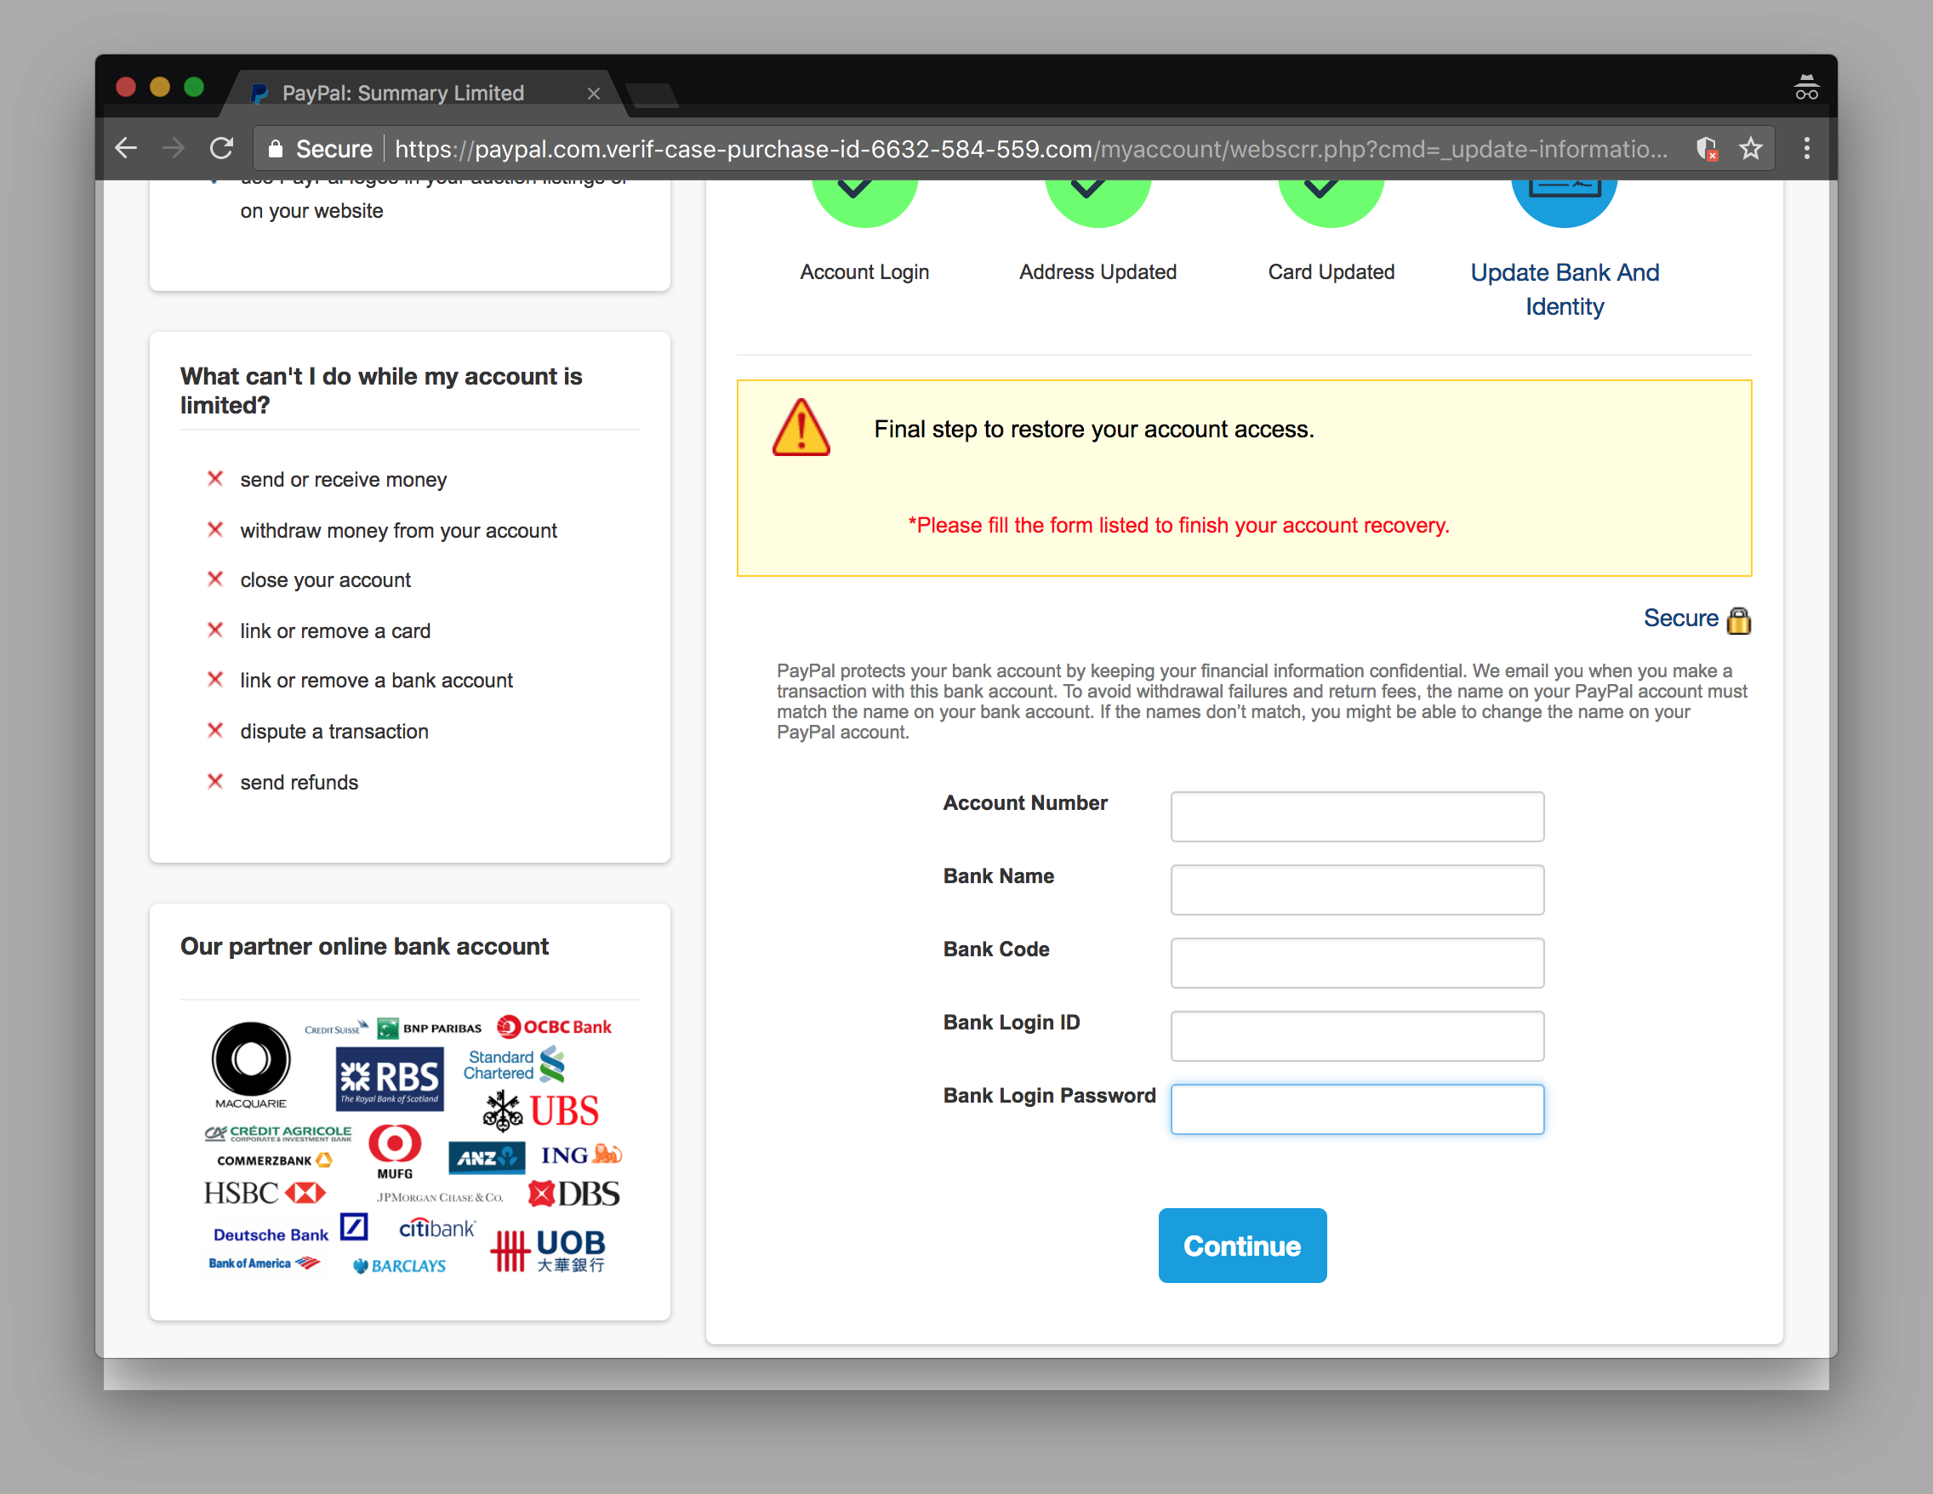
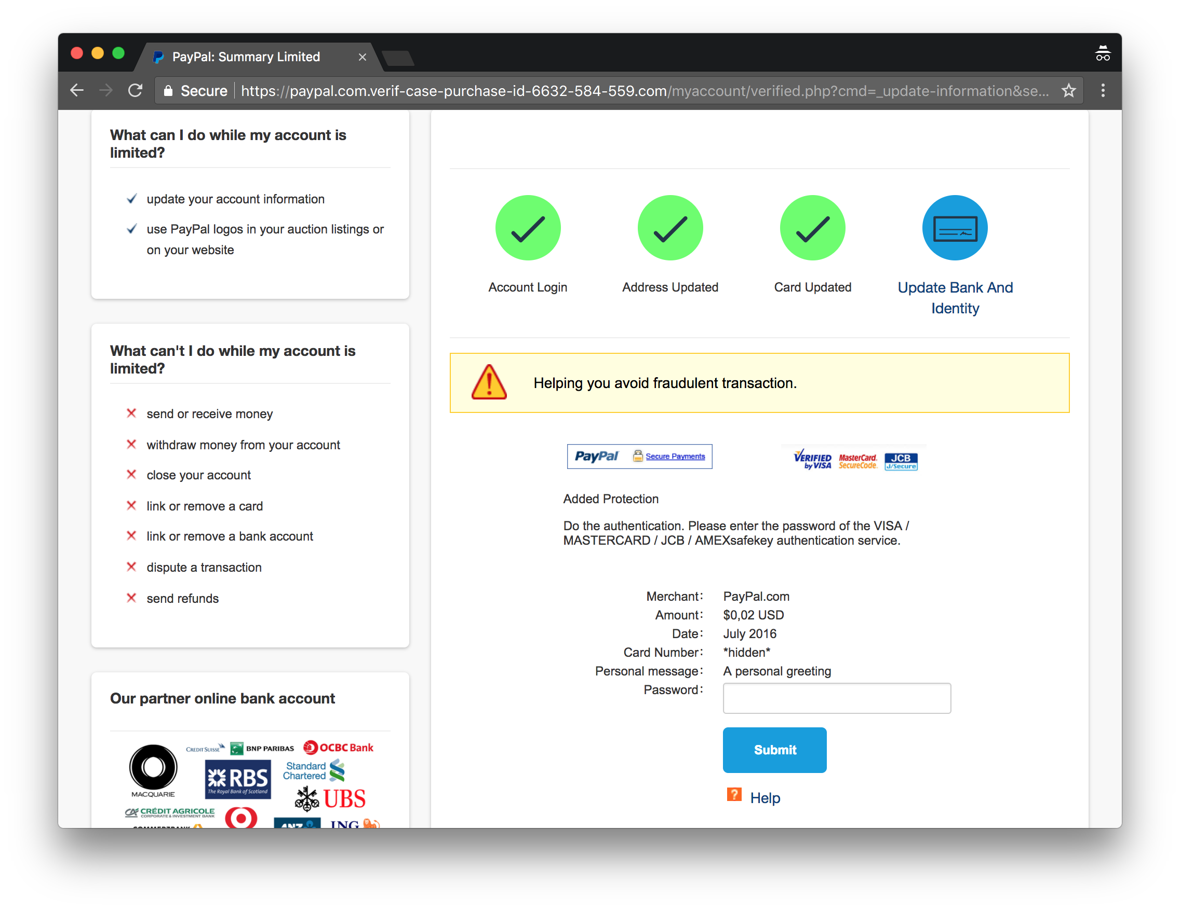
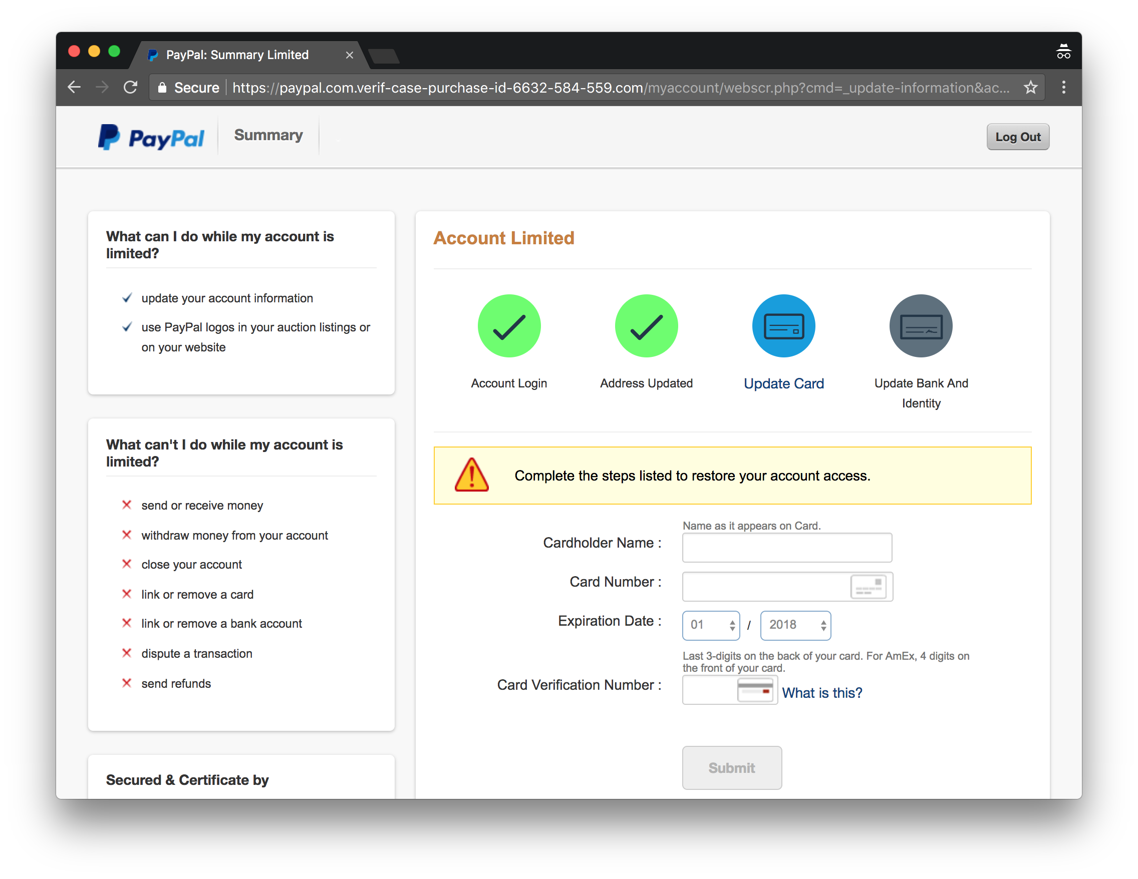
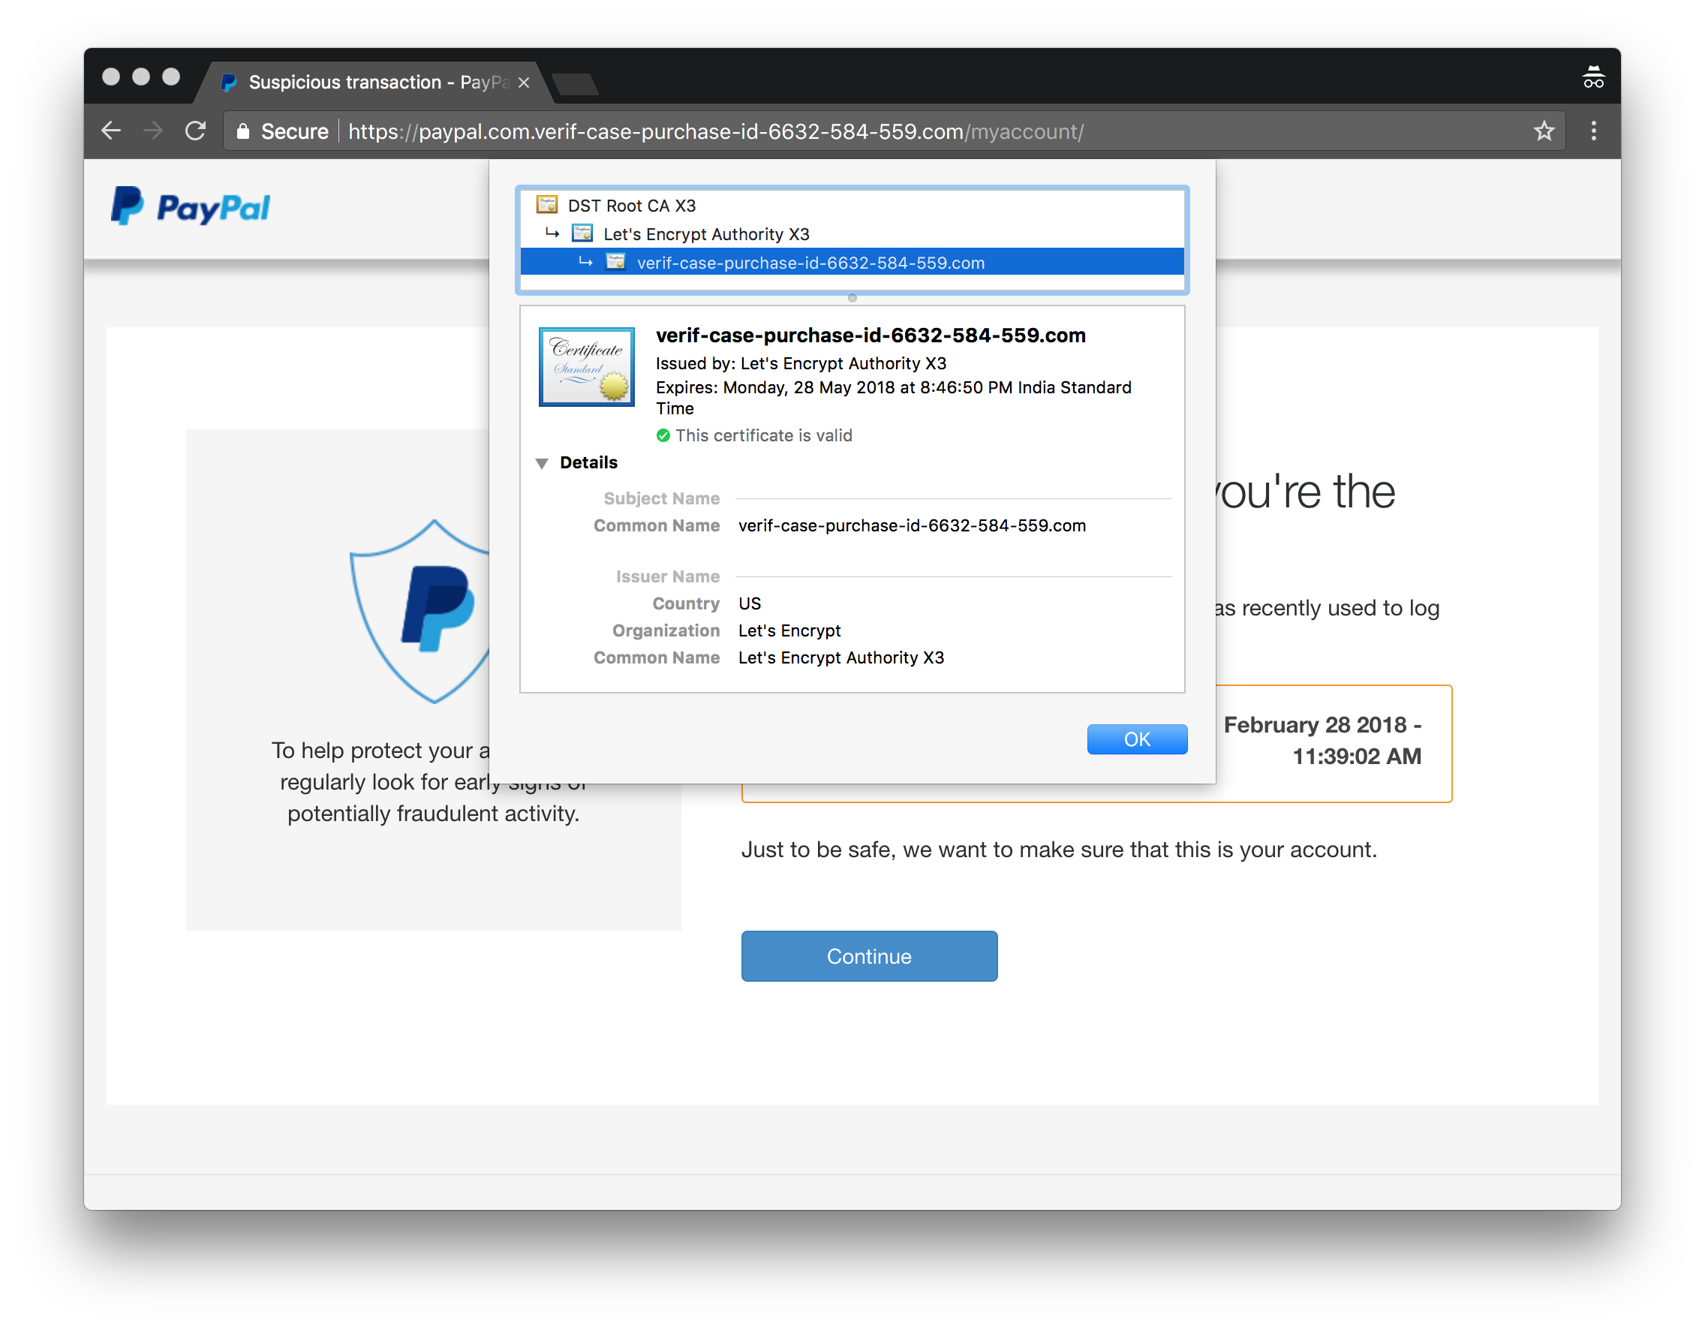
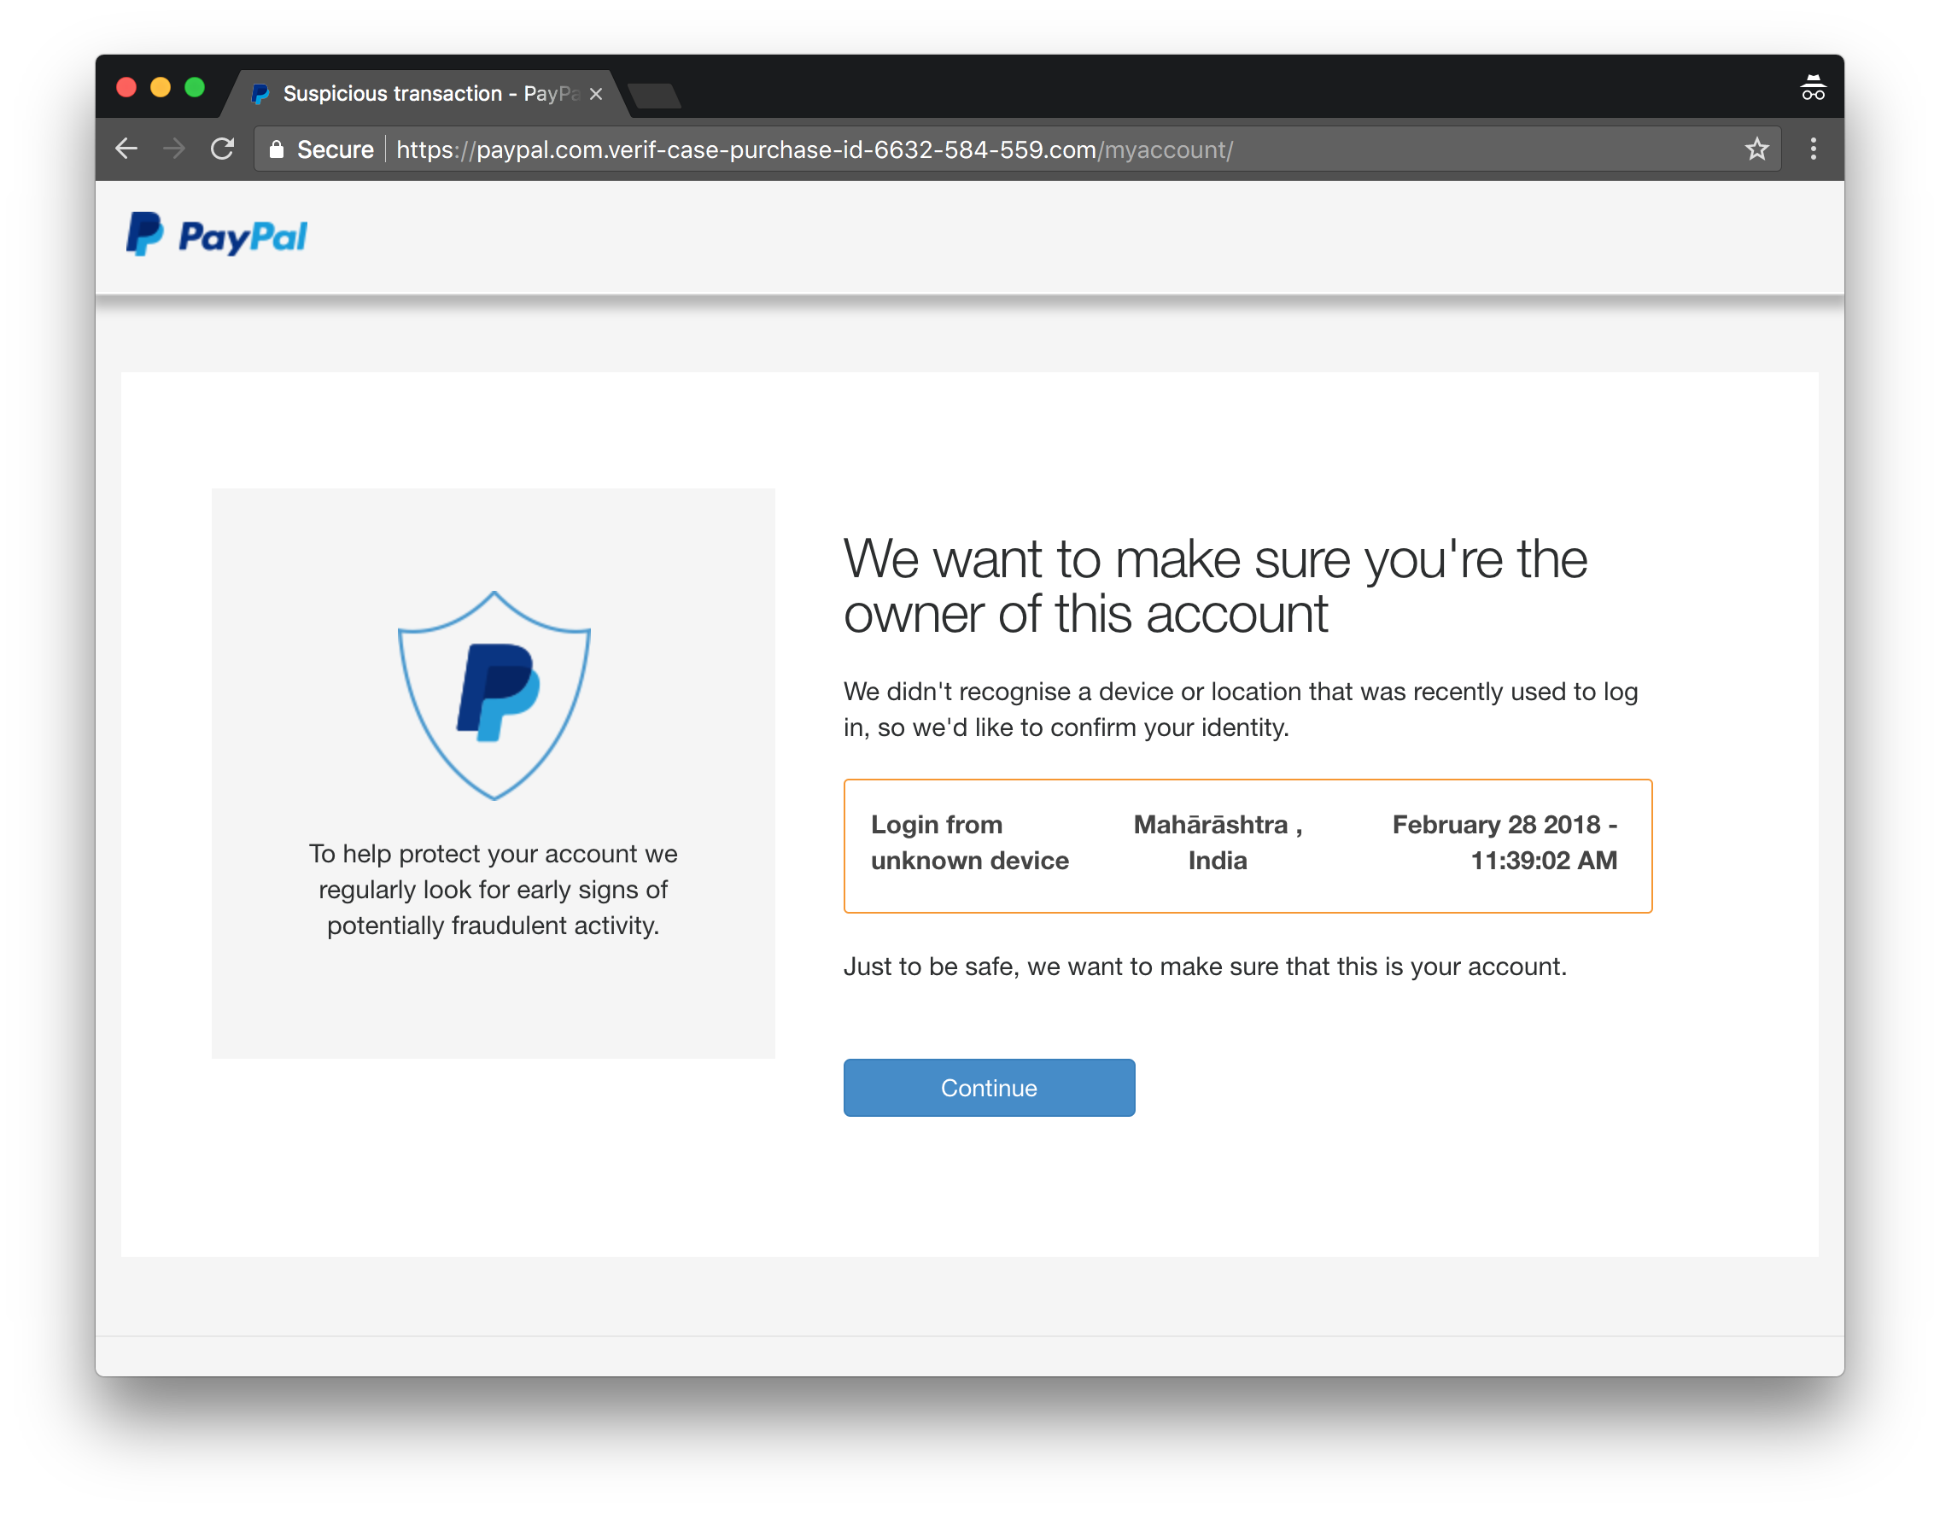
Paypal phishing kit

Slide 24
Mutual Authentication - password mgr, U2F
Password managers prevent leakage of primary credentials
As long as there is a human relying on look and feel, data leakage can still happen
paypal-phish.com
SSL certificate
“Face ID”
name, pwd
Credit card
Firefox
✔
✔
Human
Browser

Slide 25
Where can we improve defence?
Messaging - too many media
Services - too many, with varying levels of security
No intermediary, unlike email - end-to-end principle
Browser
Handful of browsers dominate the market
Phishing page must be visible here, even if it is cloaked to everyone else
Innermost circle of defence

Slide 26
We’re losing the arms race
PhishTank stats
Pages submitted: ~60,000 / month
Verified valid: ~10,000 / month
Median time to verify: 12-60 hours
Blacklists good, but necessarily lag several hours behind attacks
Verification effort is proportional to number of attacks
Increasingly sophisticated anti-blacklist tech
Constant user alertness is impractical; we check messages, click on links all day long

Slide 27
Arms race: advantage SpotPhish
Protection is continuous, instant: no lag
Effort is proportional to number of targets protected (~10s), not number of phishing replicas (~1000s)
O(1) vs O(n)
Immune to blacklist evasion tech
We stop trying to fix the user; help them identify bad situations without imposing a constant mental burden
Lasting advantage over the bad guys in the arms race

Slide 28
Finally...
Future
Machine learning
Open source!
MIT license
Feedback welcome: dev@spotphish.com

Slide 29
Design Constraints
Don’t fix the user. No expectation that users radically change their browsing habits, or be continuously watchful.
One-time user setup, no continuous cognitive load.
No reliance on web services or browser vendors to implement proposed enhancements.
No assumptions on password management.
No compromise on user privacy, or browsing speeds for the common case.
Should be O(1) in maintenance.
Should be customizable by users to protect their own sites.

Slide 30
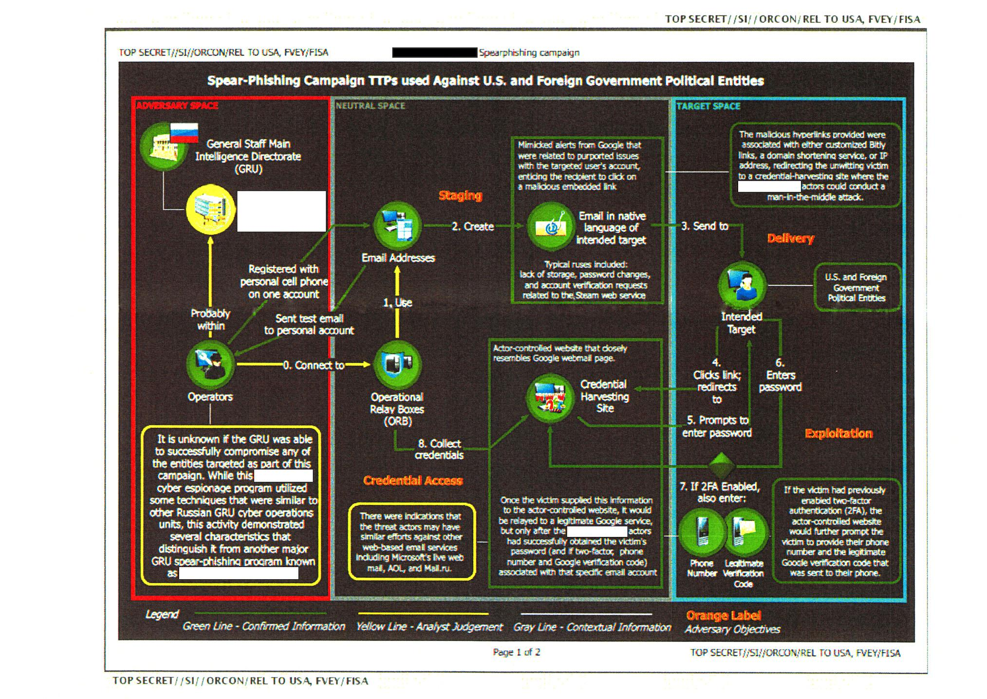

Slide 31
Google’s Phishing Statistics
Google report on stolen credentials, Mar 2016 - Mar 2017
12.4 million potential victims
4,069 phishing kits
25% of 2.3 million Gmail victims passwords match; susceptible to hijack
A year later, most victims remain unaware of password leak
Phishing provides high quality data compared to data breach, keyloggers
Geolocation, phone number, device info, secret questions
Full name, credit card, SSN
This is just what Google found - very much a lower bound on actual phishing

Slide 32
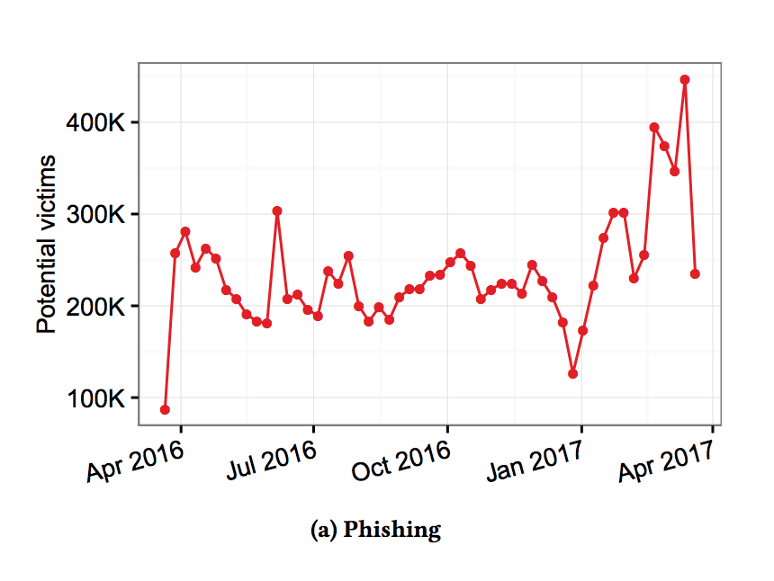
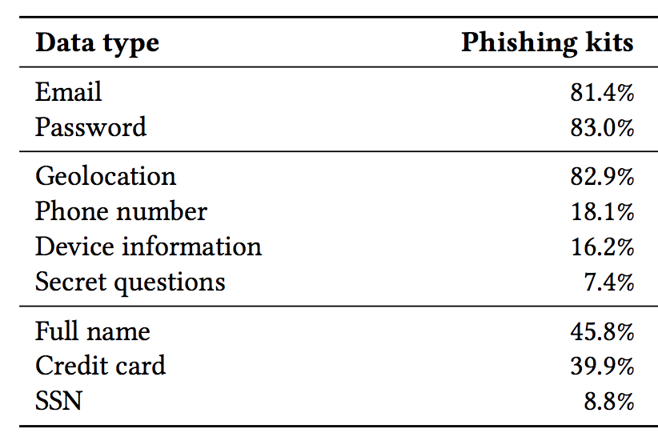
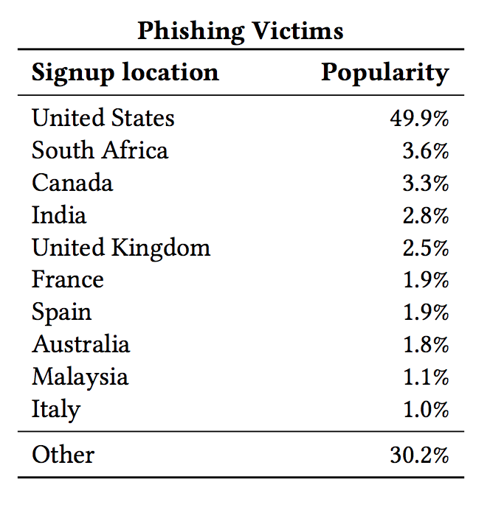
Google’s Phishing Statistics

Slide 33
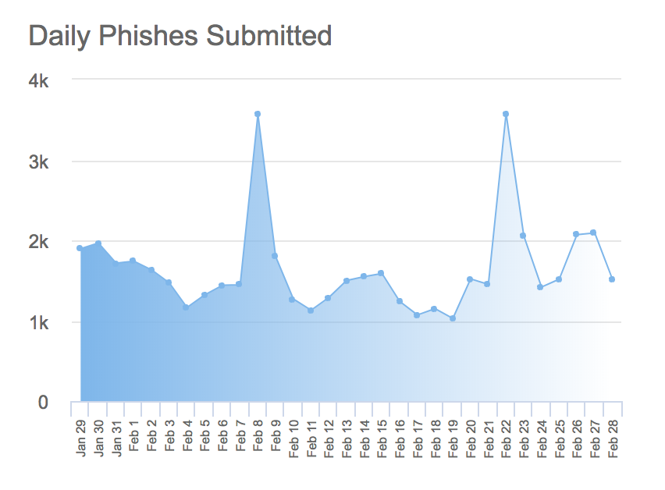
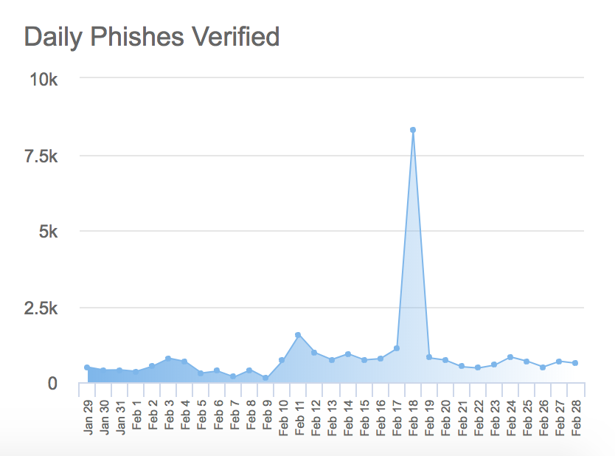
PhishTank stats

Slide 34
Email spam arms race
Viagra
Regular expression
V1agra
Update regex
OCR
RBL - block spammer IPs
Botnet
Policy block list
Multi-factor, real-time reputation
Use free webmail accounts
Require phone number for signup
VIAGRA
VIAGRA

Slide 35
Gmail’s anti-spam strategy
Large volume of cleartext samples of ham and spam
Spam filter needs to do feature extraction itself to guarantee honesty
Extremely high speed multi-factor reputation engine
< 3 minutes, otherwise too much “first-time” spam gets through
Accounts must be cheap for the individual, yet cost money in bulk
Phone verification
Source: Mike Hearn’s post on “Modern anti-spam and E2E crypto”

Slide 36
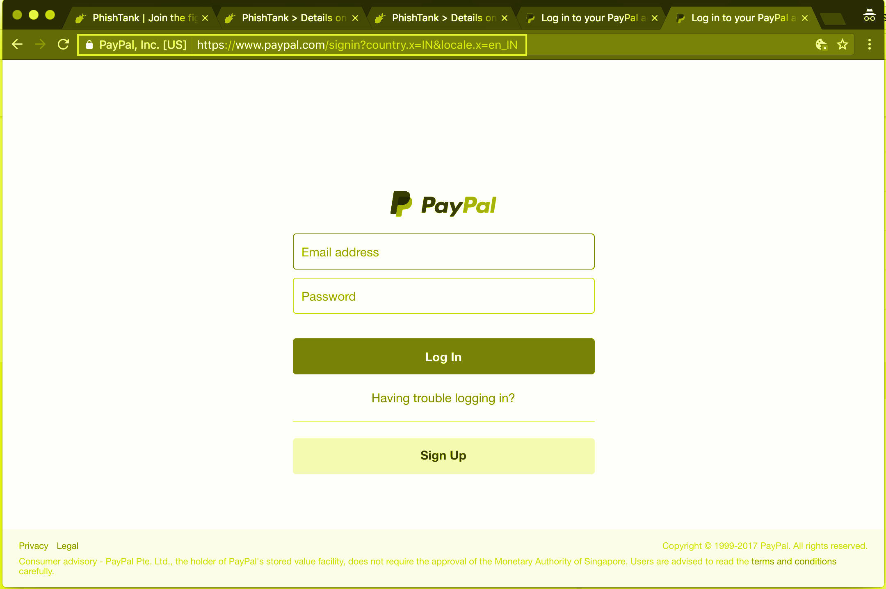
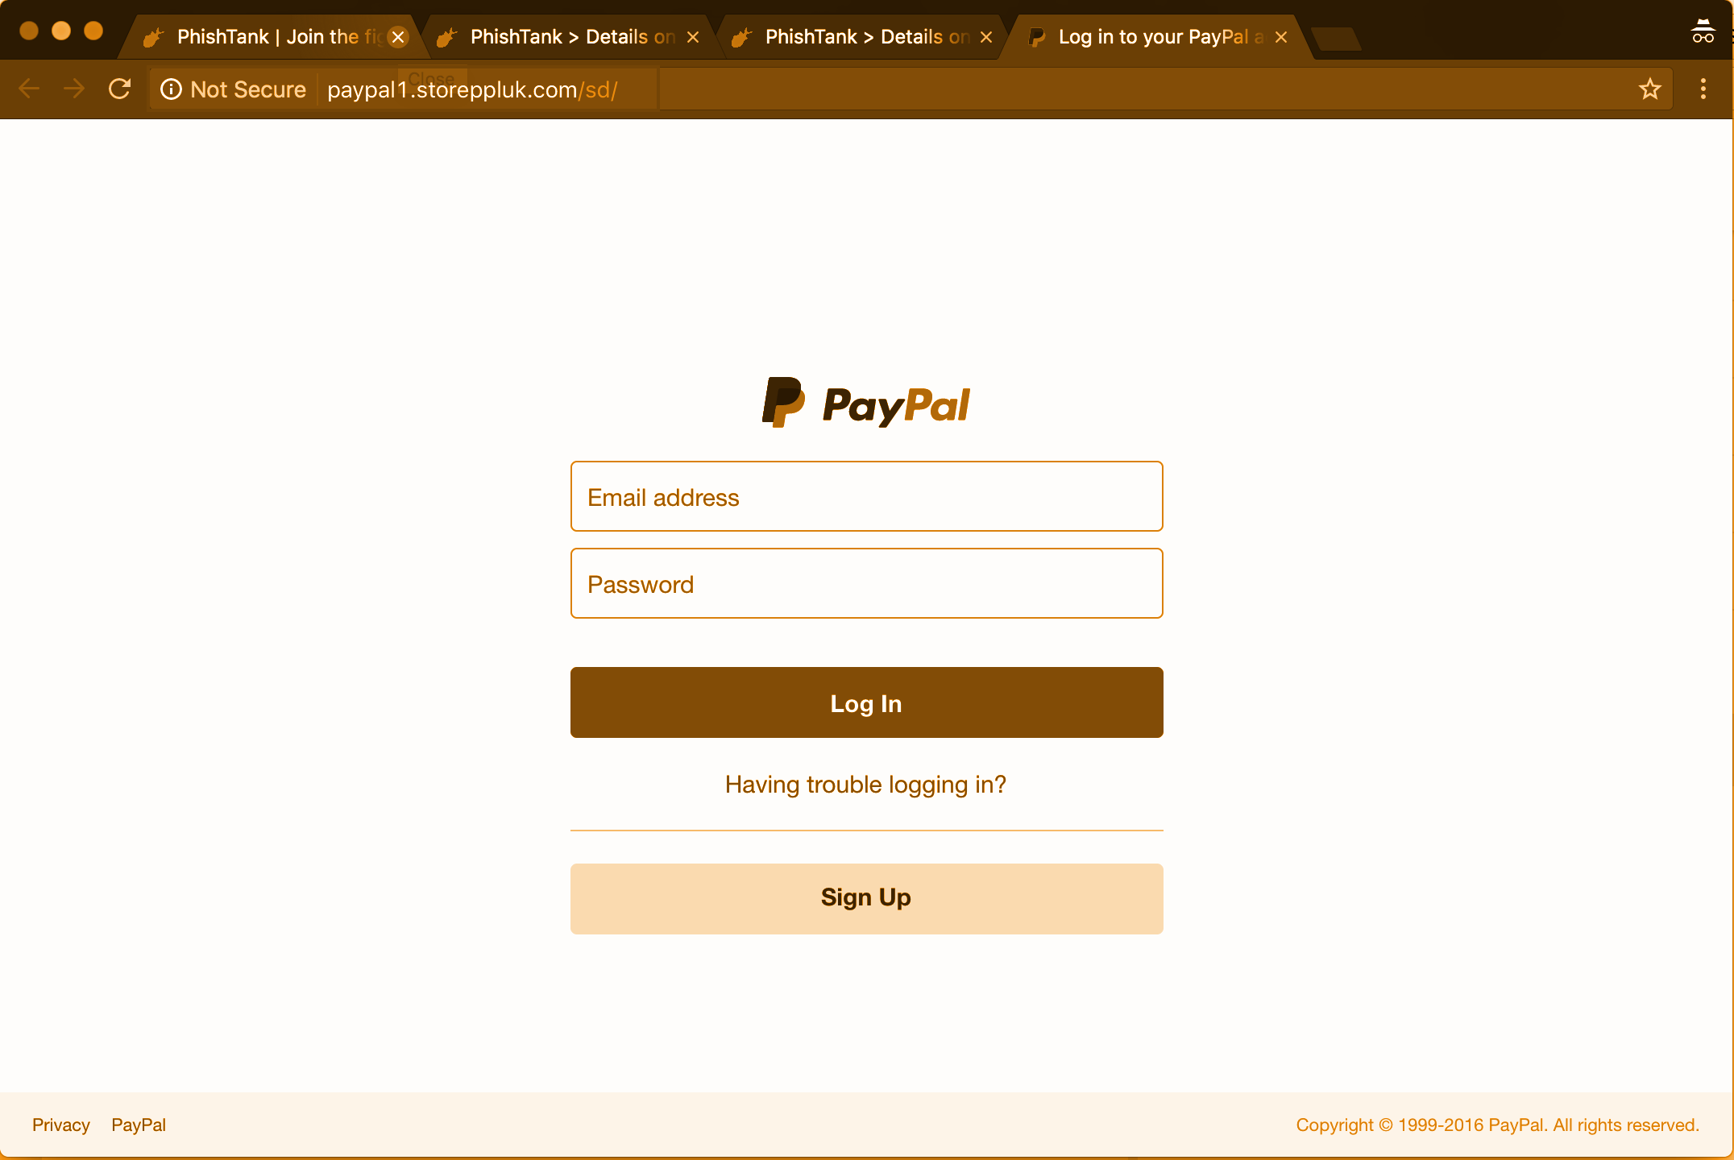
What if we had magic glasses?
Diff(Real, Fake) = 2x
Diff(Real, Baseline) = x
Diff(Fake, Baseline) = x
Real
Baseline
Fake

Slide 37
The SpotPhish approach
A phishing page may obfuscate HTML, evade blacklists, but visually, it must look like the original page in order to fool humans
“See” a page like a human, not a tree of HTML: computer vision techniques

Slide 38
The SpotPhish approach
Help humans identify phishing scenarios by magnifying the difference between legit and phishing workflows
Legit pages overlaid with personal security image
Identified phishing pages overlaid with warning
Whitelist based: 80/20 rule
Most phishing attacks happen on Paypal, followed by Facebook, Google, Microsoft, Apple
Users can add their own sites: corporate, bank, insurance

Slide 39
Security image
Secret - Not something you’ve posted online
Emotional - someone you care about
Entertaining - something which never gets old

Slide 40
Phishing detection
If an (untrusted) page contains a password field, or the user enters keyboard data, snap and check
Compare ORB features of screenshot with library of logos
Completely private: Processing in-browser; screenshot discarded; no exfiltration
Accuracy rate of ~83% on Facebook, Paypal and Dropbox on the PhishTank screenshots in Nov 2017
Limitations
False positives
False negatives

